Slide 1
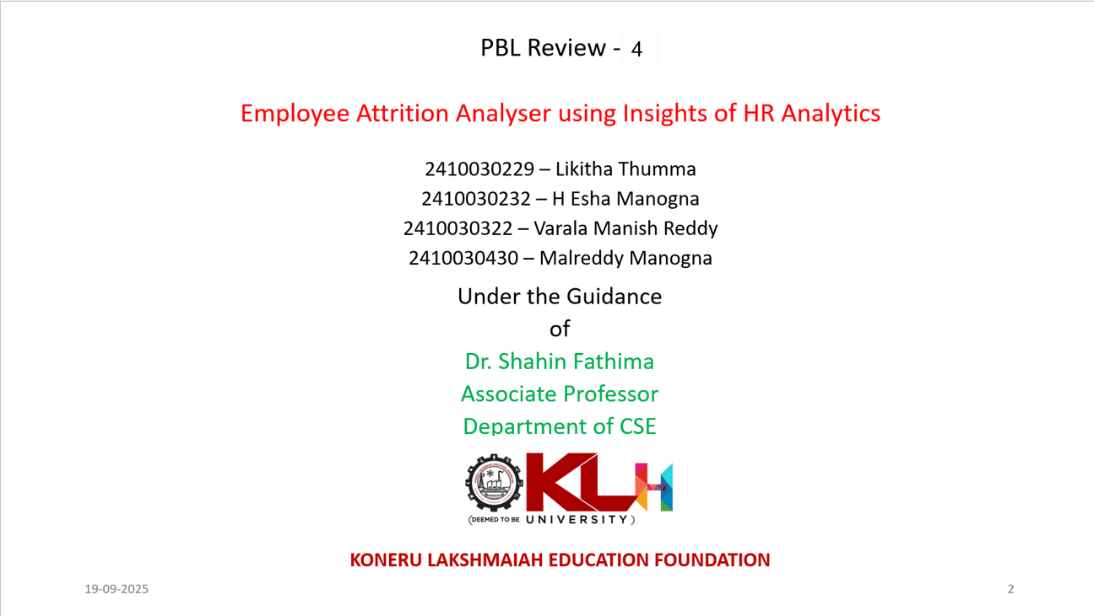

Slide 2


Slide 3
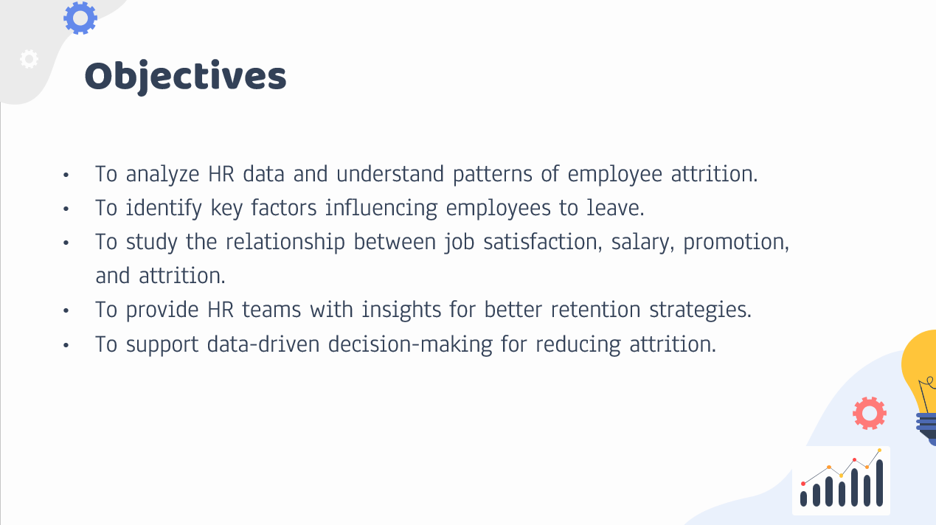

Slide 4
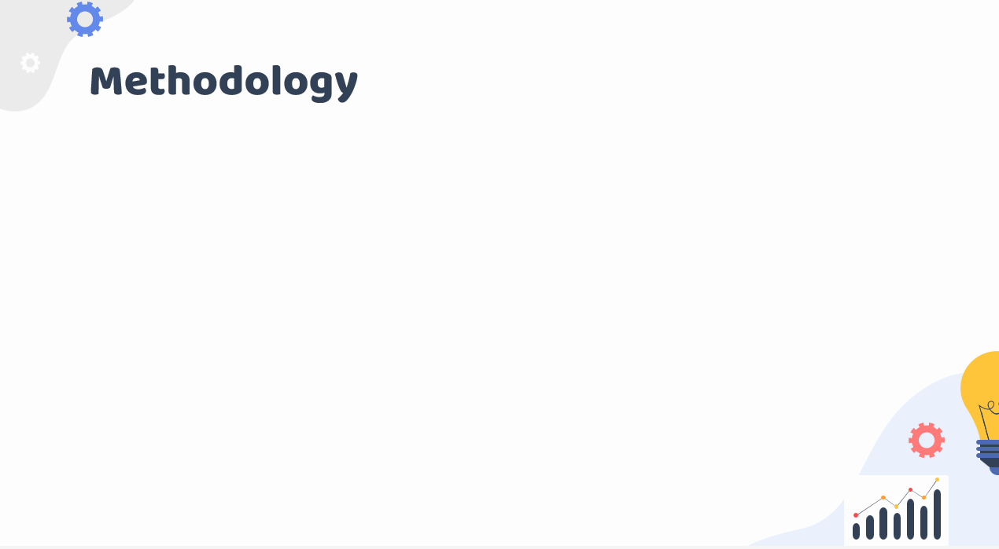
1. Data Collection
Used the IBM HR Employee Attrition dataset.
Dataset includes employee details like age, department, job role, salary, satisfaction, etc.
2. Data Preprocessing
Handled missing values and cleaned the data.
Converted categorical variables into numerical form using encoding.
Normalized numerical columns using Z-score normalization.
3. Data Analysis & Visualization
Explored data trends using graphs and charts.
Identified patterns in attrition across departments, age groups, and job roles.
4. Result Interpretation
Highlighted key factors contributing to attrition.
Provided insights for HR intervention and employee retention.

Slide 5
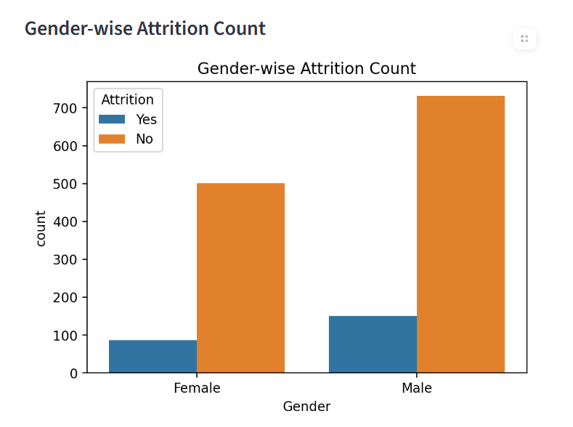
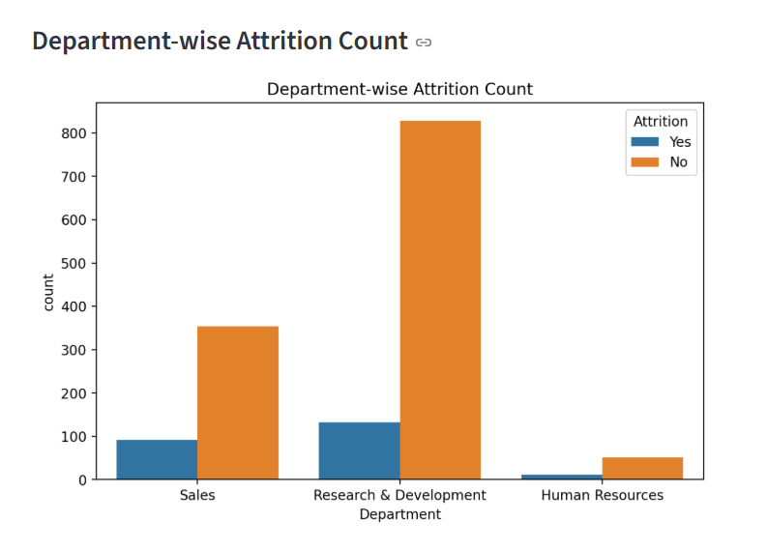
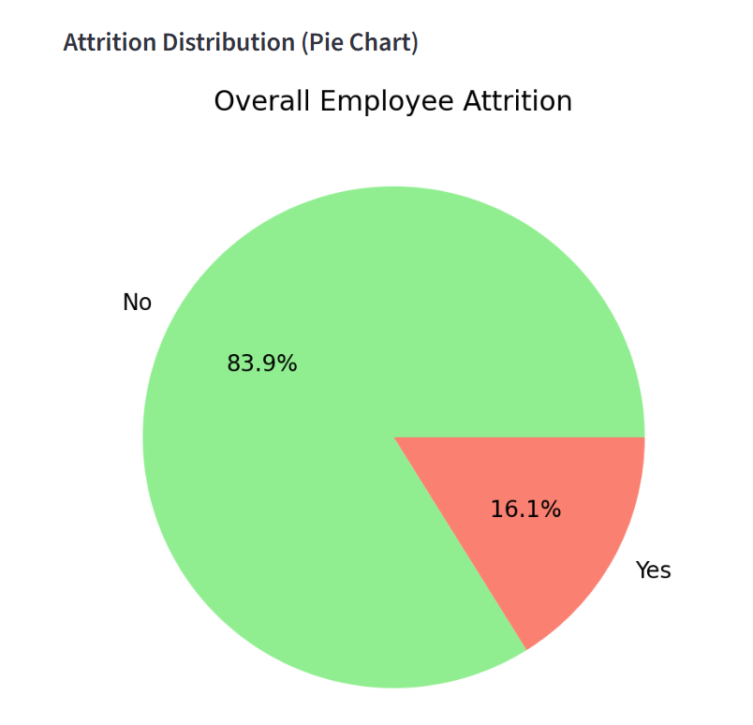
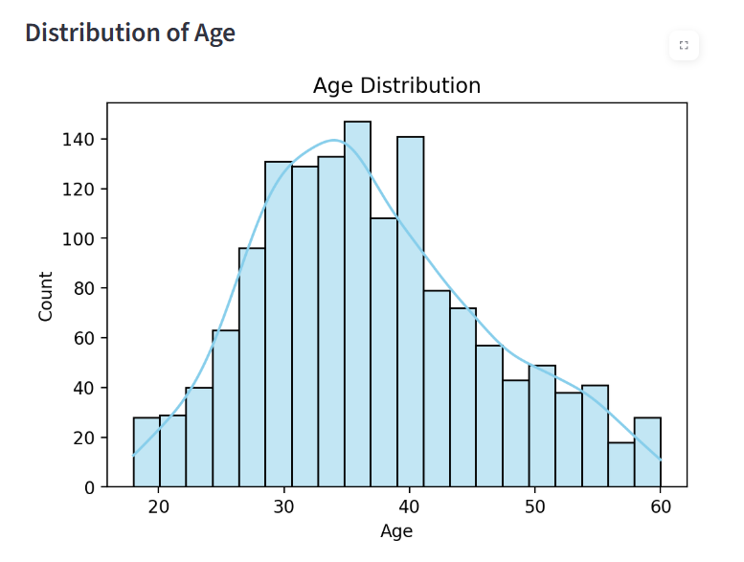
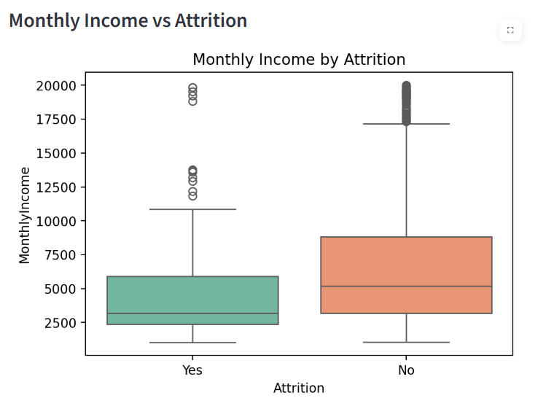
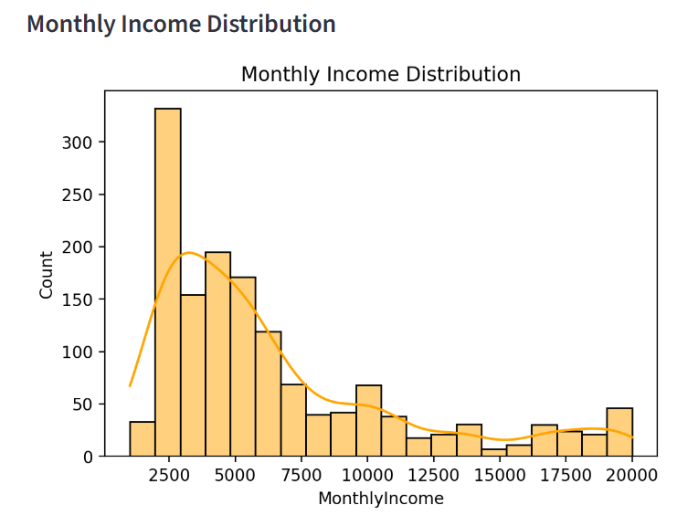
Visualizations:

Slide 6
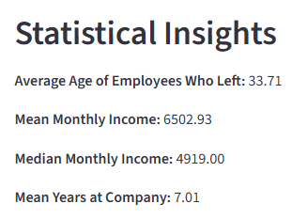

Slide 7
Conclusion:
Predicts employee attrition to help HR plan retention strategies.
Identifies key factors contributing to employees leaving.
Supports data-driven decision-making for workforce management.
Enables proactive interventions to reduce turnover and improve employee satisfaction.

Slide 8


